Slide 1
Spiral Model

Slide 2
It is best suited for complex embedded product development and situations where the requirements are changing from customers side
It support risk handling by evaluating the risks in each stage
It is the combination of waterfall and iterative model
The exact number of loops of the spiral is unknown and can vary from project to project
Each loop of the spiral is called a phase of the software development process

Slide 3
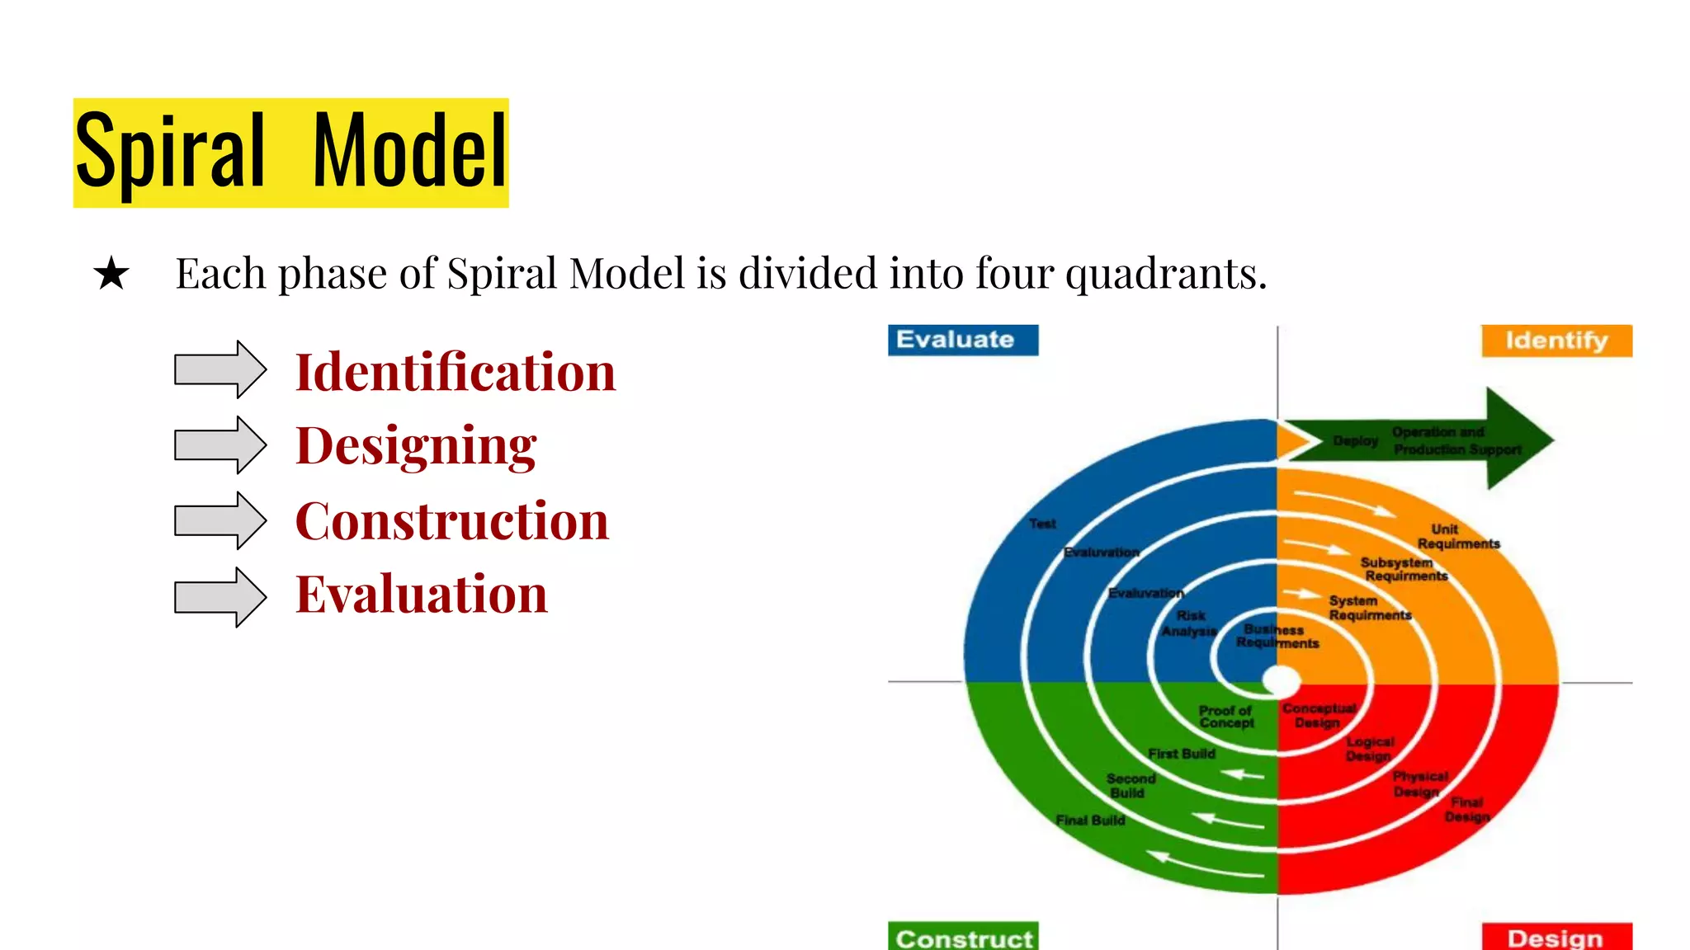

Slide 4
Identification
This phase starts with gathering the requirements
This phase also includes understanding the system requirements by continuous communication between the customer and the system analyst
The objectives are identified elaborated and analyzed at the start of every phase

Slide 5
Designing
This involves architectural design ,logical design of modules ,physical product design and the final design in the subsequent spirals
At the end of the quadrant prototype is build

Slide 6
Construction
This phase refers to production of the actual software product
The identical features are developed and verified through testing
At the end of the third quadrant , a new version of the software is available
These builds are sent to the customer feedback

Slide 7
Evaluation
In the fourth quadrant the customer evaluate the so far developed version of the software
The software development process enters the iteration and subsequently follows the linear approach to implement the feedback suggested by the customer
The process of iterations along the spiral continues throughout the life of the software

Slide 8
Advantages
Support risk handling
Best suited for larger projects
Flexibility in requirements
Customer satisfaction

Slide 9
Disadvantages
More complex than any other SDLC models
Not suitable for small projects as it is expensive
Too much dependable on risk analysis
Difficulty in time management

